Slide 1
Graphic designer
Maths in the workplace

Slide 2
How our teaching resources are designed for the classroom

Slide 3
I can understand how maths is used by graphic designers.

Slide 4
A graphic designer creates visuals for various projects such as adverts, branding, magazines, packaging and websites.

Slide 5

Graphic designer
The golden ratio
Rotational symmetry in art

Slide 6

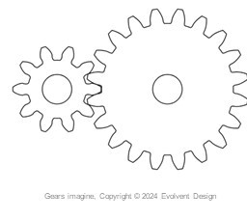

The golden ratio
A graphic designer creates visuals for various projects such as adverts, branding, magazines, packaging and websites.

Slide 7
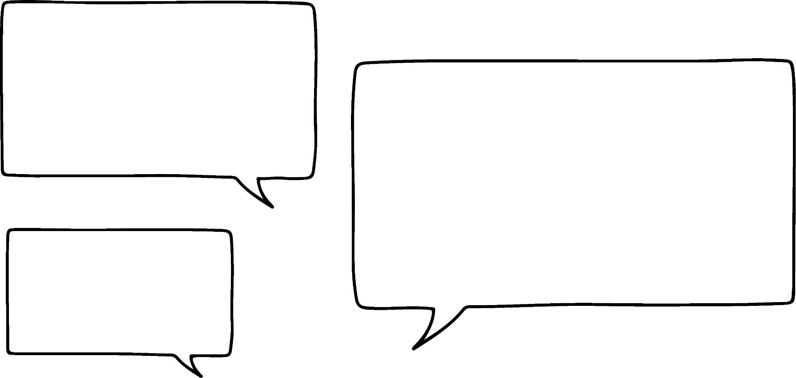
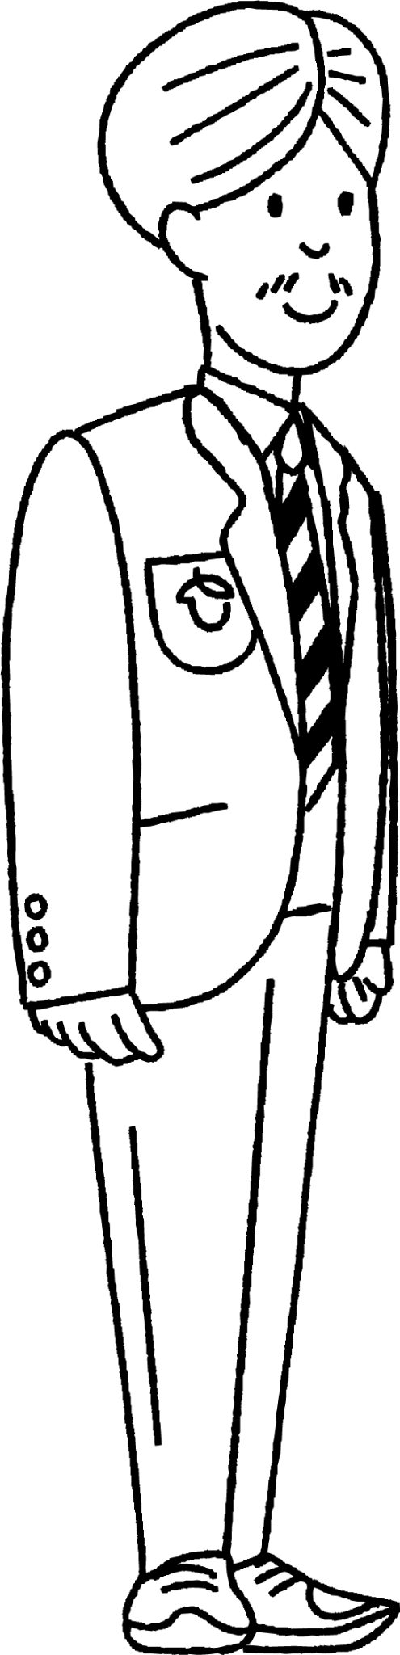
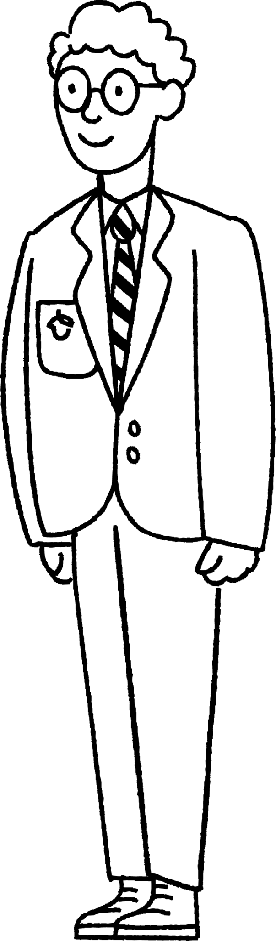
The golden ratio
But how has maths been used to generate these images?
Part of the design work involved some maths referred to as ‘the golden ratio’.
Andeep
Alex

Slide 8

The golden ratio
Two quantities are in the golden ratio if their ratio is the same as the ratio of their sum to the larger of the two quantities.
For example, if we have two quantities a and b then a and b are in the golden ratio if:
a : b = b : a + b
This can also be expressed as:

Slide 9
The golden ratio
But how is that actually useful?
Hmm, let’s turn that into something more visual.
Andeep
Alex

Slide 10
The golden ratio
The two coloured squares are the same size.
The next square has a length which is approximately 1.618 times the length of a small coloured square.

Slide 11
The golden ratio
This pattern continues and the next square has a length which is approximately 1.618 times the length of the previous square.

Slide 12
The golden ratio
By drawing within the squares, images can be created.

Slide 13
The golden ratio
This is a quickly put together image.
Graphic designers can produce more complex images using these ‘building blocks’.

Slide 14

The golden ratio
A graphic designer creates visuals for various projects such as adverts, branding, magazines, packaging and websites.
Graphic designers work on various projects and maths can aid them in designing images that will appeal to the public.

Slide 15
The golden ratio
1) Design a logo for a company using the golden ratio template.
Write a paragraph detailing why your logo represents the company well.
For example, if you chose a restaurant chain and you designed a burger then this logo is in keeping with what the restaurant chain stands for.

Slide 16
The golden ratio
Template

Slide 17
The golden ratio
1) E.g. Using the template, I placed circles in each smaller section.

Slide 18
The golden ratio
1) E.g. I used copies of these to design my logo.

Slide 19
The golden ratio
1)
I have designed a logo for a company that sells products aimed at toddlers.
The teddy is made from circles which means the teddy has a soft ‘round’ appearance. It looks cuddly and safe for children.

Slide 20
Graphic designer
The golden ratio
Rotational symmetry in art

Slide 21
Rotational symmetry in art
The golden ratio is not the only bit of maths that graphic designers can use to help create images.
Rotational symmetry can also help.

Slide 22
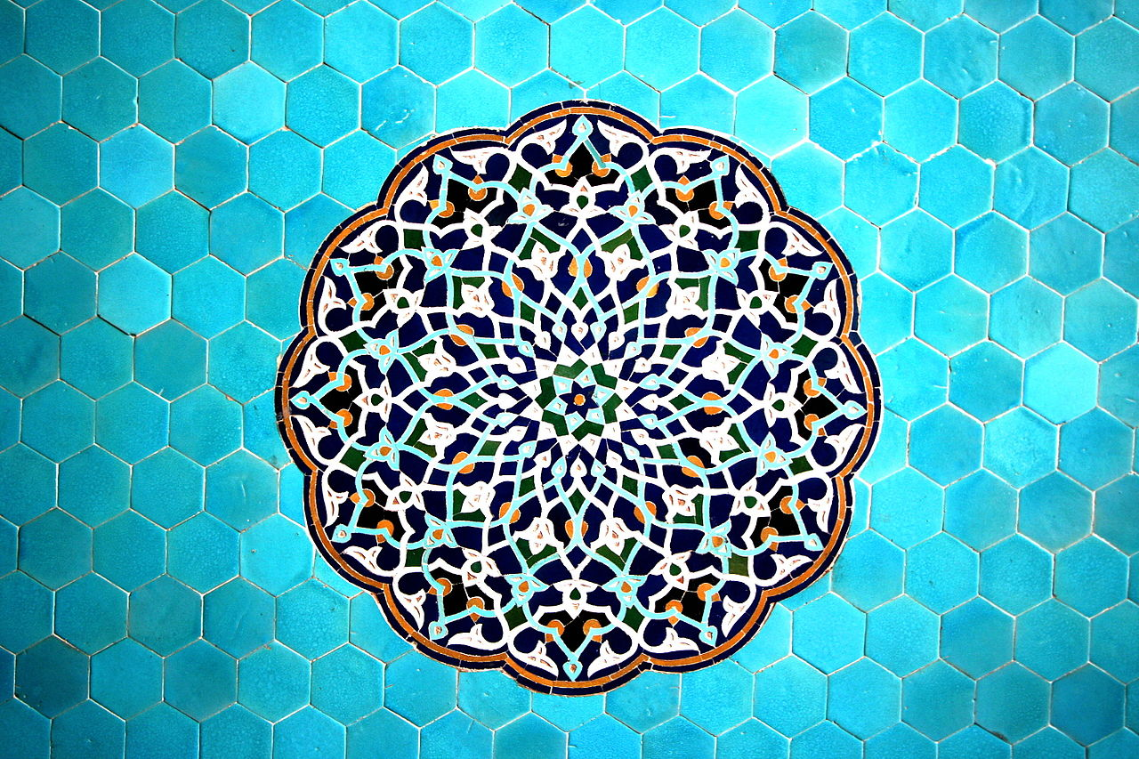
Rotational symmetry in art
Islamic designs are sometimes created from the repeated use of basic shapes. Beautiful, complex designs are the result.
What shapes can you see in this design?

Slide 23
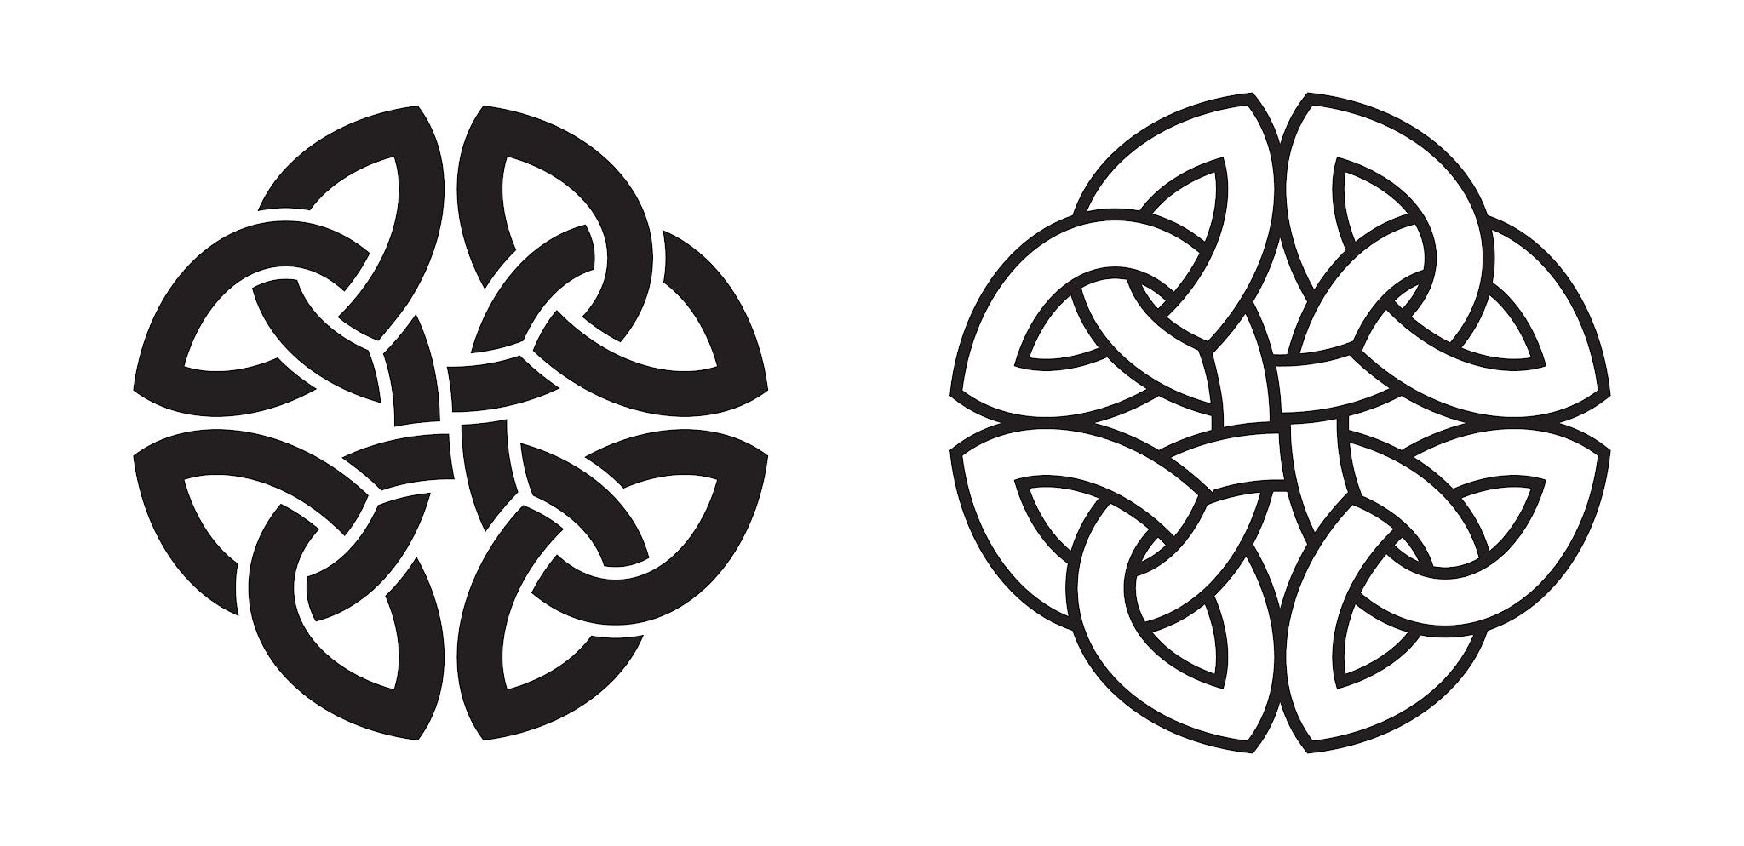
Rotational symmetry in art
Celtic designs, such as this version of the Celtic knot, also rely on rotational symmetry

Slide 24
Rotational symmetry in art
Only Western cultures use geometric shapes in their designs.
Many different cultures create patterns using geometric shapes. You could research other cultures that do this.

Slide 25
Rotational symmetry in art
Does it matter whether there is rotational symmetry?
Let’s consider two designs made entirely from triangles.
Andeep
Alex

Slide 26
Rotational symmetry in art
With rotational symmetry Without rotational symmetry
Which do you prefer?

Slide 27
Rotational symmetry in art
1) a) Create a design using basic shapes. Your design should have rotational symmetry.
b) Create a second version of your design that does not have rotational symmetry.

Slide 28
Rotational symmetry in art
2) Show your two designs to your classmates/friends/family. Ask them ‘Which image appeals more to you?’
Record the results.
3) Create a chart to display your results. Which image is more popular? Why do you think this is?

Slide 29
Rotational symmetry in art
1) a) Create a design using basic shapes. Your design should have rotational symmetry.
b) Create a second version of your design that does not have rotational symmetry.

Slide 30
Rotational symmetry in art
Design 1 Design 2

Slide 31
Rotational symmetry in art
2) Show your two designs to your classmates/friends/family. Ask them ‘Which image appeals more to you?’
Record the results.
Design 1 | Design 2

Slide 32
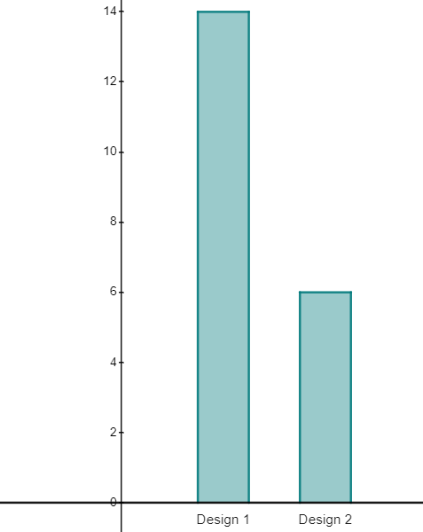
Rotational symmetry in art
3) Create a chart to display your results. Which image is more popular? Why do you think this is?
E.g. Design 1 is more popular. I think this is because the first design made a repeating pattern and this is more appealing than the jumbled mess of the second design.

Slide 33
Graphic designer
A graphic designer creates visuals for various projects such as adverts, branding, magazines, packaging and websites.
Images that have rotational symmetry are often very appealing.

Slide 34

© Oak National Academy 2024.
Produced in partnership with Mathematics in Education and Industry.
Licensed on the Open Government Licence v3.0, except where otherwise stated. See Oak terms and conditions.

